Slide 1
Message System
Ishara St. Phard Deondre De Freitas
si5591 dd2144
ishara.stphard91@myhunter.cuny.edu deondre.defreitas44@myhunter.cuny.edu
CSCI-435
thanks to IBM Cloud sponsored by Power Systems Academic Initiative

Slide 2
Problem Statement
The system would allow an instructor to be in touch with students who are working on the same server.
It is a messaging system participants can send messages to one or all participants.
They can review and reply to particular messages
The system will preserve message order.

Slide 3
Attributes from Problem Statement
sent_to= who the message was sent to (varchar)
time_sent= the date and time that the message was sent (varchar) - we used varchar to get the date in a nice readable format. Even though datetime would have helped with organizational things. (You’ll notice that the table is sorted by day of the week as opposed to overall date).
message_content=the contents of the message (text)

Slide 4
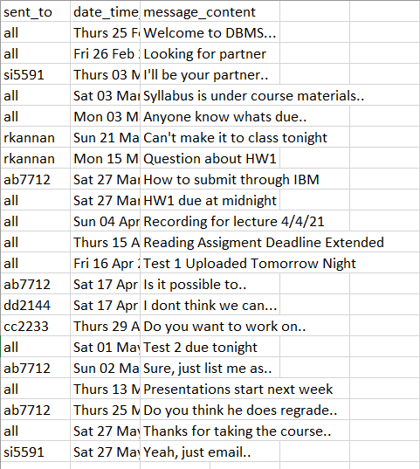
Pre-Normalized Data Definition
load data local infile '/home/2021/hunter/spring/435/si5591/MsgApp.csv' into table MsgHist fields terminated by ',' optionally enclosed by '"' lines terminated by '\n' ignore 1 rows(sent_to,time_sent,message_content);
MsgApp.csv

Slide 5
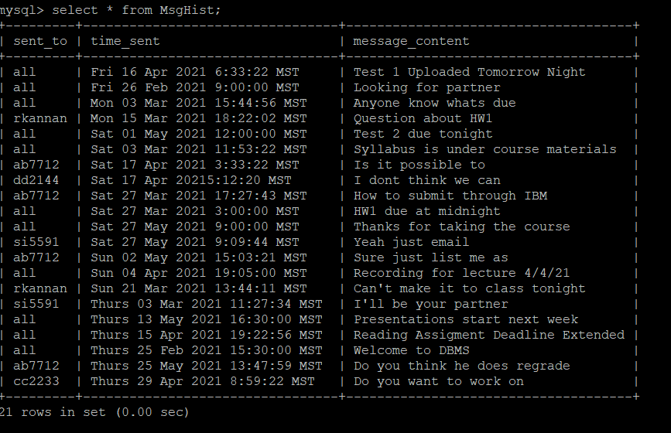
continued
create table MsgHist( sent_to varchar(255), time_sent varchar(255), message_content TEXT);
alter table MsgHist add primary key (sent_to, time_sent);

Slide 6
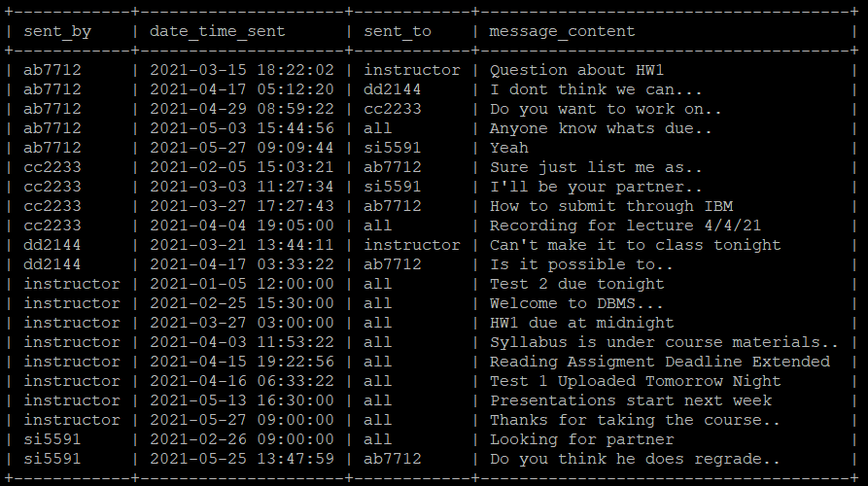
1st Normal Form
Primary Keys - sent_to,
time_sent
Our table is already in 1NF.
There are unique names for
attributes.

Slide 7
2nd Normal Form
We believe there to be partial
dependency for the “message_content”
Column. Message content is not
Entirely dependent on who sent
that message.
Created the Messages table by:
create table Messages AS select message_content from MsgHist;

Slide 8
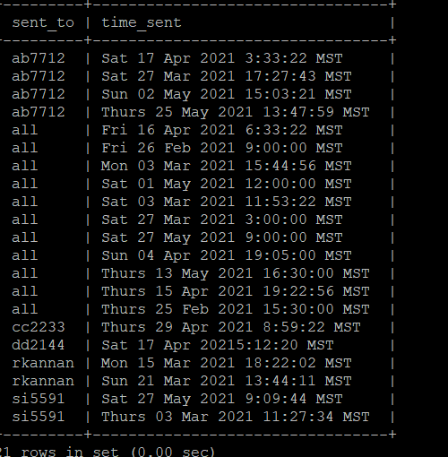
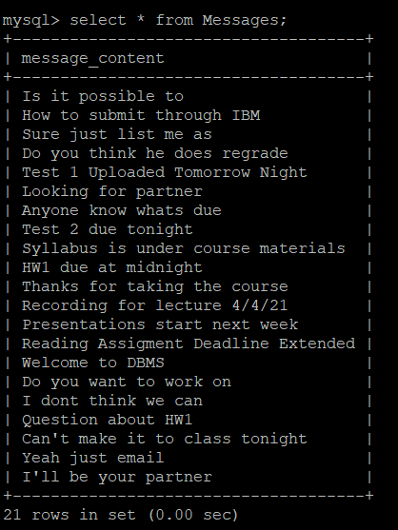
2NF Cont

Slide 9
3rd Normal Form
There is no
transitive dependency for our data set.

Slide 10
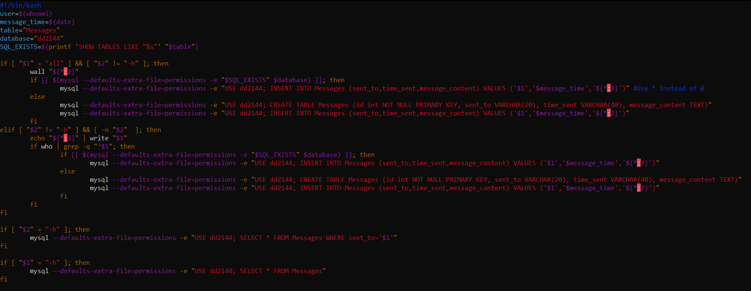
How we loaded data from Bash to MySQL
We ended up writing a bash script to facilitate sending messages to users on the same server.

Slide 11
DEMO
=)

